Slide 1
The Trials and Tribulations of Predicting the Future for Learning Technology
Dr. Charles Severance
University of Michigan School of Information
Longsight, Inc.
LAK 2015 – Poughkeepsie, NY – 17-Mar-2015
#LAK15

Slide 2
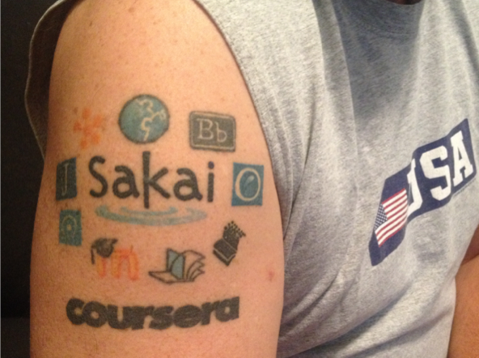
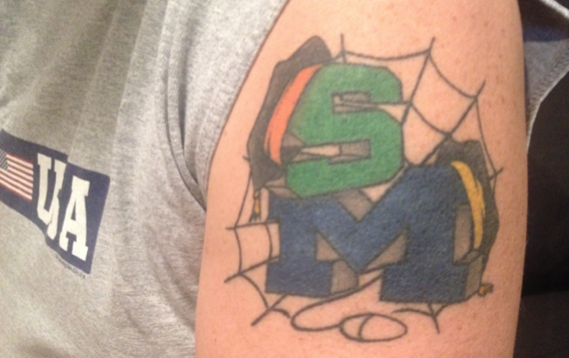
This presentation is Copyright All Rights Reserved 2001-2015, Charles R. Severance and others. Please do not record, remix, or reuse without explicit written permission.
#LAK15

Slide 3
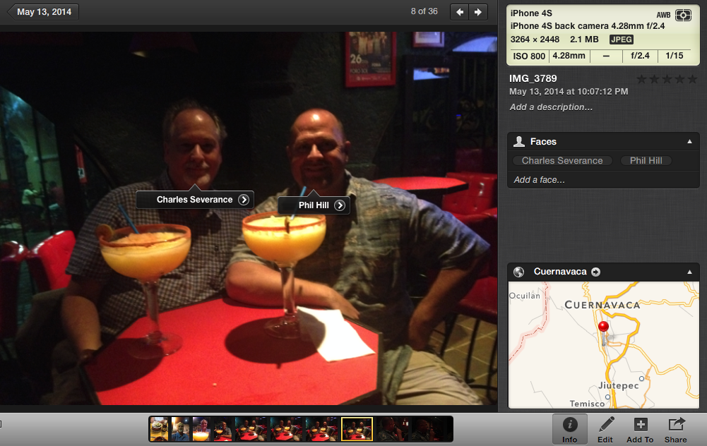


Slide 4
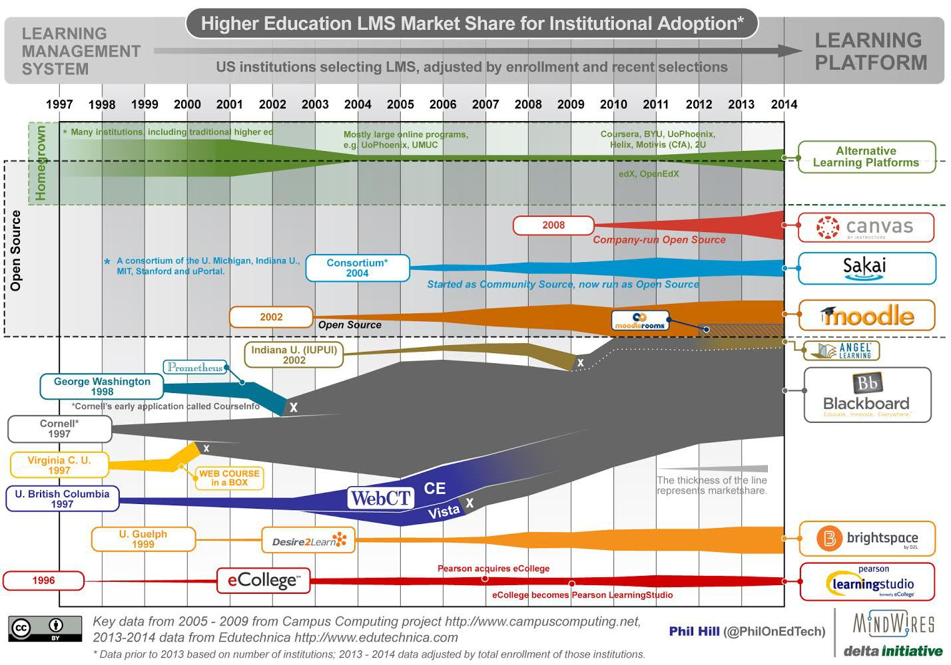
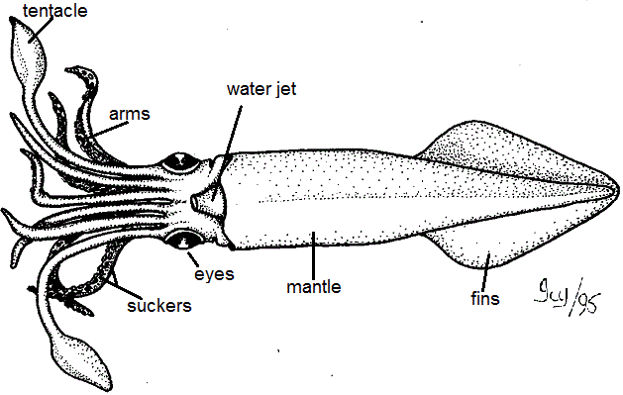
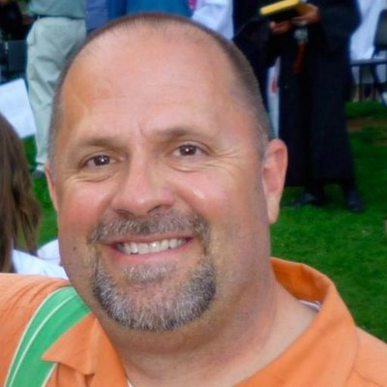
LMS
Squid
Diagram
http://mfeldstein.com/state-us-higher-education-lms-market-2014-edition/
Notes:
Google "LMS Squid Diagram" and "Squid Diagram"

Slide 5
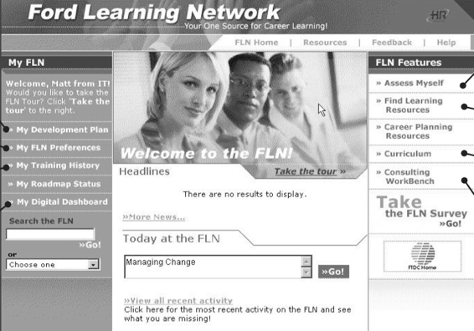
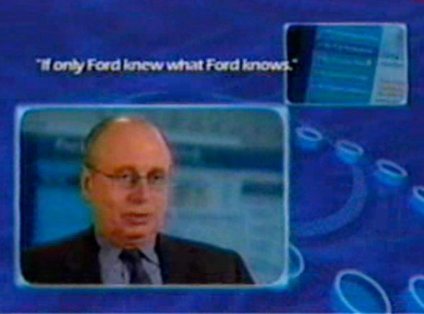
2:23 – "Deceptively Simple"
#LAK15
Notes:
2001

Slide 7
When Was That Filmed?
1990
1995
2000
2005
2010
2015
#LAK15

Slide 8
2001
OKI was funded Dec-2000 2.4 Million
OKI OSIDs invented in 2001
MIT OCW Funded June-2001 $5.5M
32 courses Sept-2002
Creative Commons Founded
http://mfeldstein.com/state-us-higher-education-lms-market-2014-edition/

Slide 9
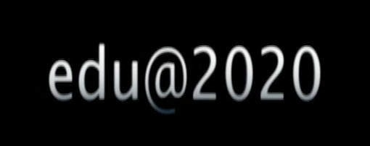


In 2006 Richard N. Katz was retiring as the President of Educause
He made a video in 2006 with a series of bold predictions about the changes that we would see in the world of education over the next 14 years
4:01
#LAK15
Notes:
University of Phoenix founded in 1976, Open University (UK) Founded 1969 – through 1980

Slide 10
2006
Sakai / Moodle Emerging
WebCT just purchased by Bb
Patent wars – not yet
IMS LTI will not happen for four more years (2010)
http://mfeldstein.com/state-us-higher-education-lms-market-2014-edition/

Slide 11
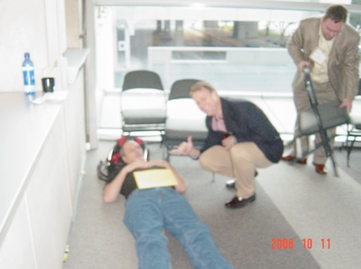
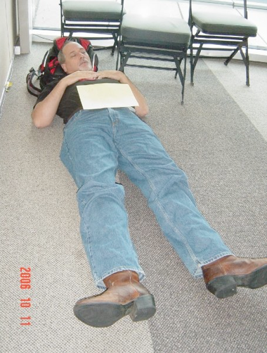
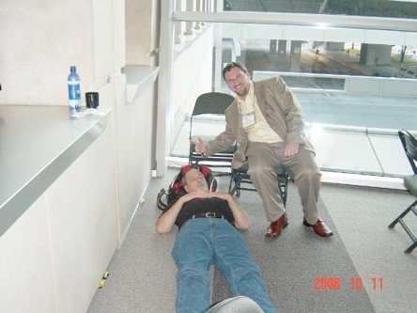
October 2006 - Dallas
#LAK15

Slide 12
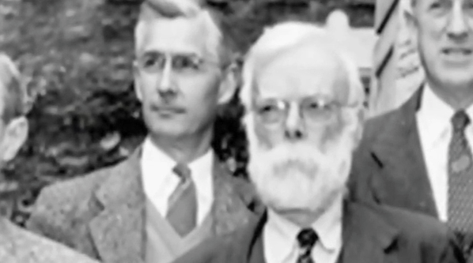

Richard N Katz. predictions 2002-2015
What was the best prediction
What was the workst prediction
5:44
#LAK15
Notes:
Richard N. Katz

Slide 13




Richard N Katz. predictions 2002-2015
What was the best prediction
What was the workst prediction
5:44
#LAK15

Slide 14
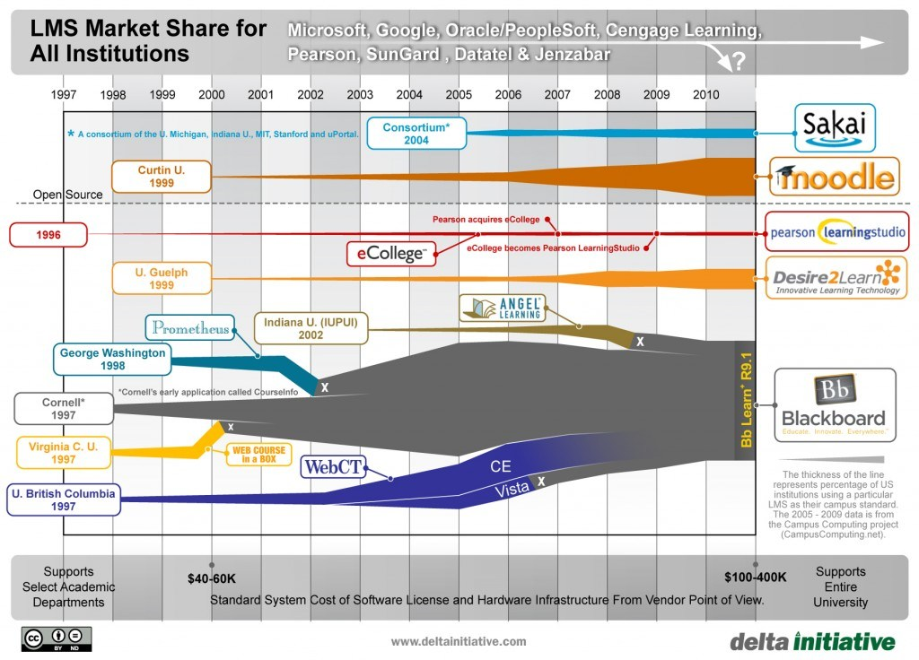
2011
Market is
Brittle
Ripe for
Disruption
What is
missing?
http://mfeldstein.com/state-of-the-higher-education-lms-market-a-graphical-view/
Notes:
Microsoft, Google, Oracle, Peoplesoft, Cengage, Pearson, SunGard, Datatel and Jenzabar

Slide 15
2012
Coursera / Udacity / edX Founded
Canvas gaining momentum
Angel / MoodleRooms / Dr. Chuck acquired by Blackboard
http://mfeldstein.com/state-us-higher-education-lms-market-2014-edition/

Slide 16
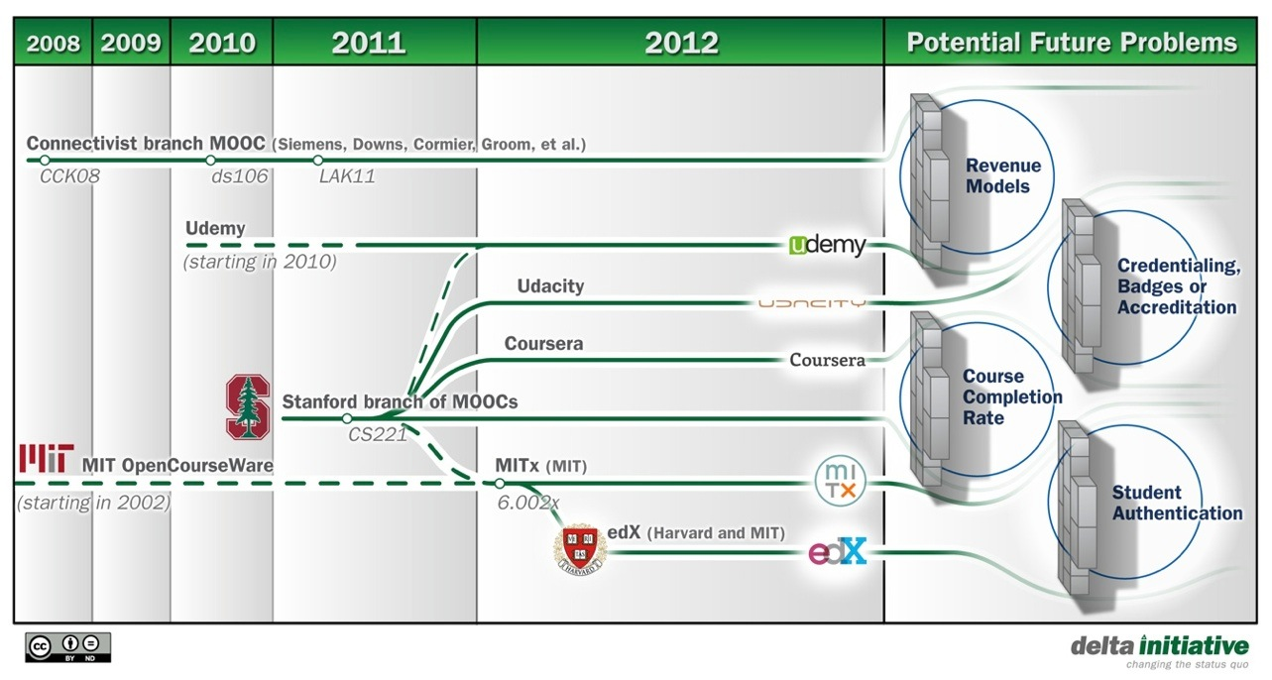

Slide 17
2014
Learning Platform
Standards
Interoperability
Analytics
http://mfeldstein.com/state-us-higher-education-lms-market-2014-edition/
Notes:
Meghan Trainor, It is all abut that Bass – I am bringing booty back...

Slide 18
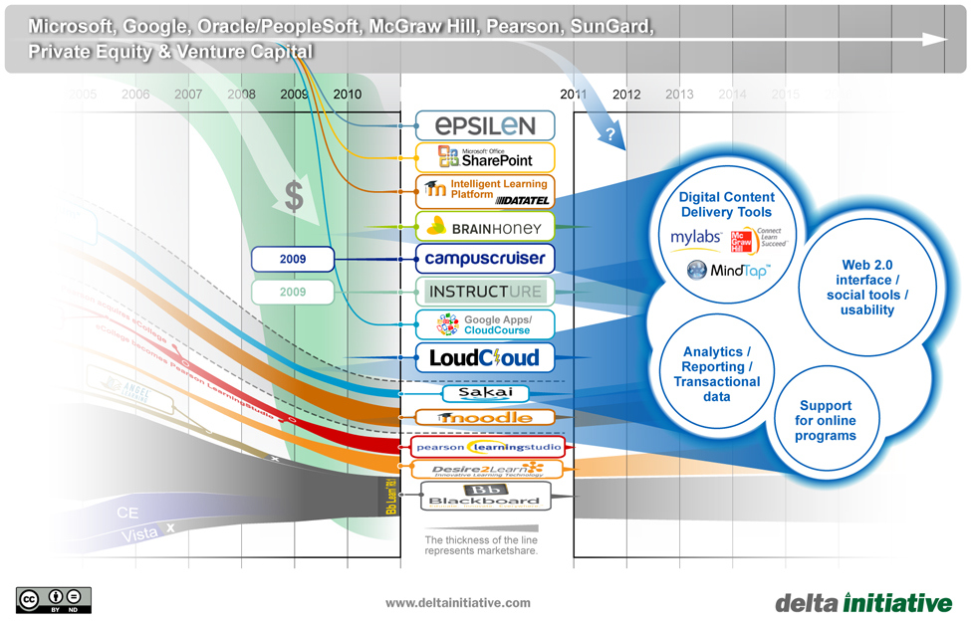
http://mfeldstein.com/emerging-trends-in-lms-ed-tech-market/

Slide 19
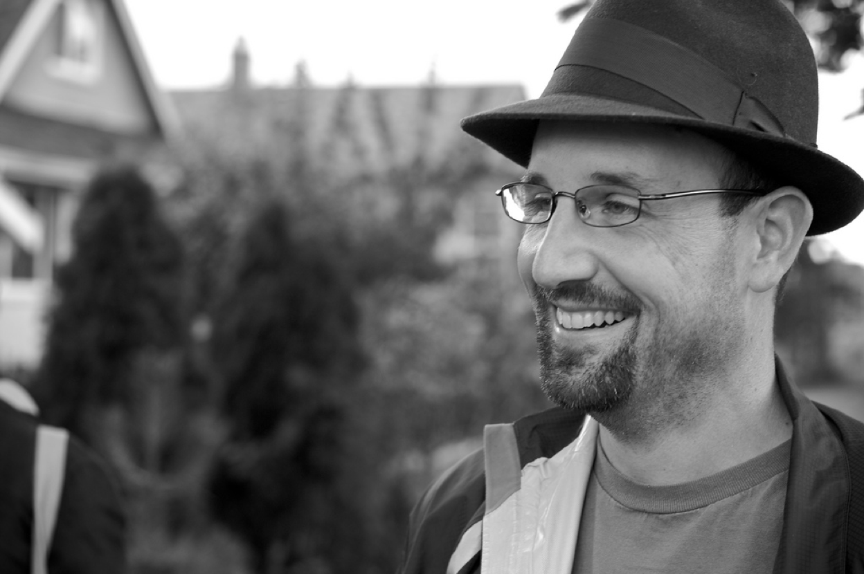
D'Arcy Norman's Law of eLearning Tool Convergence
Any eLearning tool, no matter how openly designed, will eventually become indistinguishable from a Learning Management System once a threshold of supported use-cases has been reached.
http://darcynorman.net/2013/02/15/normans-law-of-elearning-tool-convergence/

Slide 20
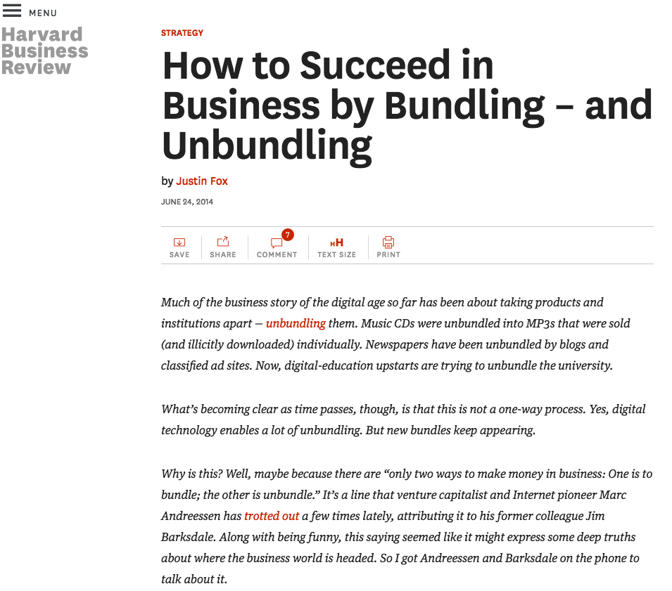
My old boss, Jim Barksdale, used to say there’s only two ways to make money in business: One is to bundle; the other is unbundle. Basically media is getting re-bundled. And so you’ve got these new models—Spotify in music, Netflix in video, and Amazon in eBooks, right?
-- Marc Andreessen
https://hbr.org/2014/06/how-to-succeed-in-business-by-bundling-and-unbundling/
http://a16z.com/2013/12/18/the-future-of-work-cars-and-the-wisdom-in-saying-no/

Slide 21
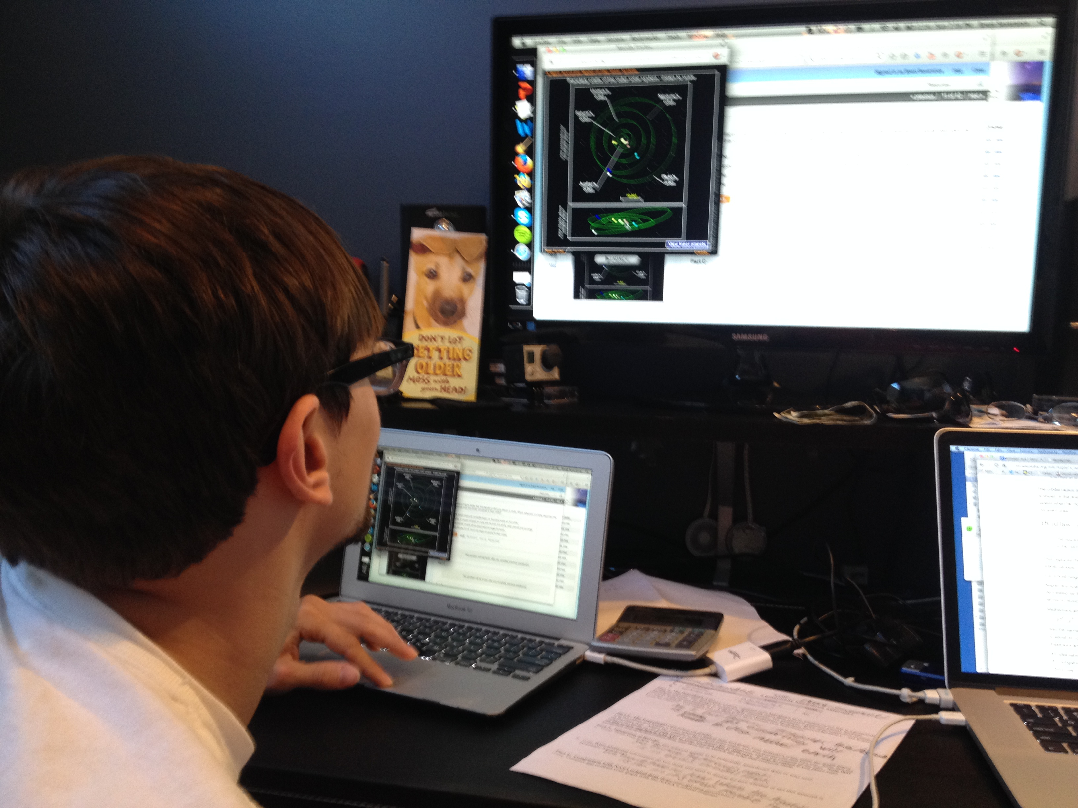
#LAK15

Slide 22
One of these things is not like the others:
www.masteringphysics.com
www.masteringastronomy.com
www.masteringpython.com
#LAK15

Slide 23









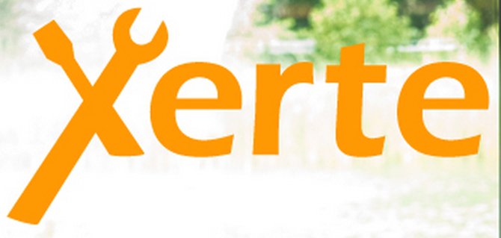

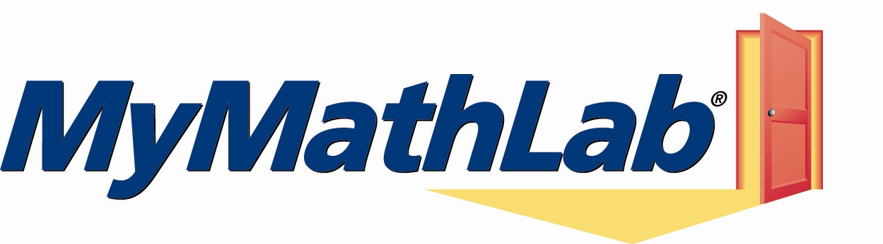



Learning
Systems
LMS
Learning Platform
#LAK15

Slide 24
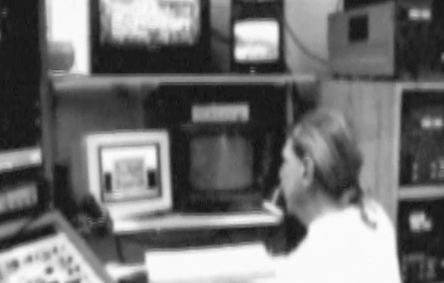
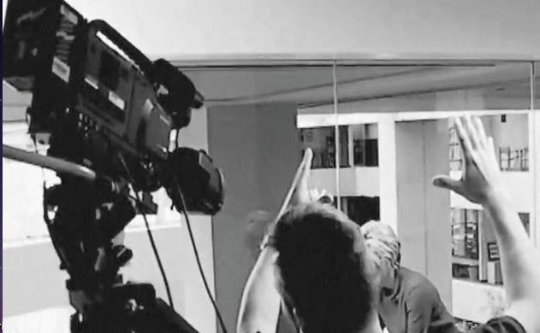
Richard N. Katz - 2015-2020
Make your own prediction about 2020
Make a prediction about what he will predict in this next video?
#LAK15

Slide 25
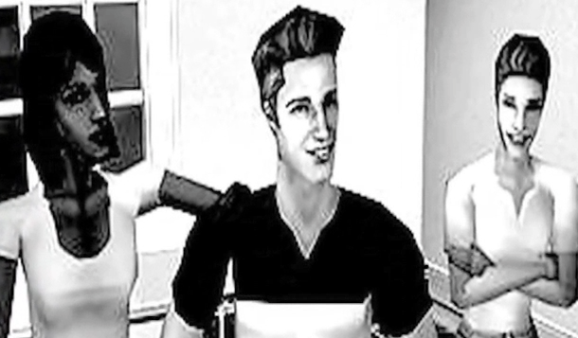
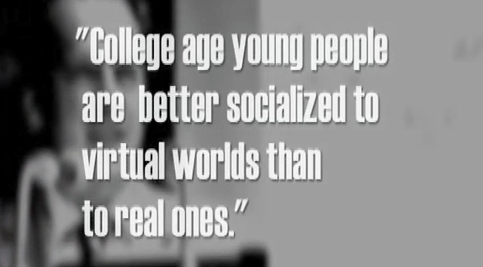
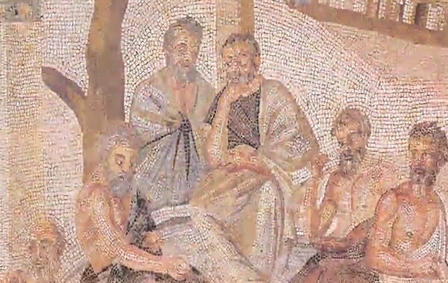
Which of his predictions will be right and which will be wrong and why?
2010-2020
5:44
#LAK15

Slide 26

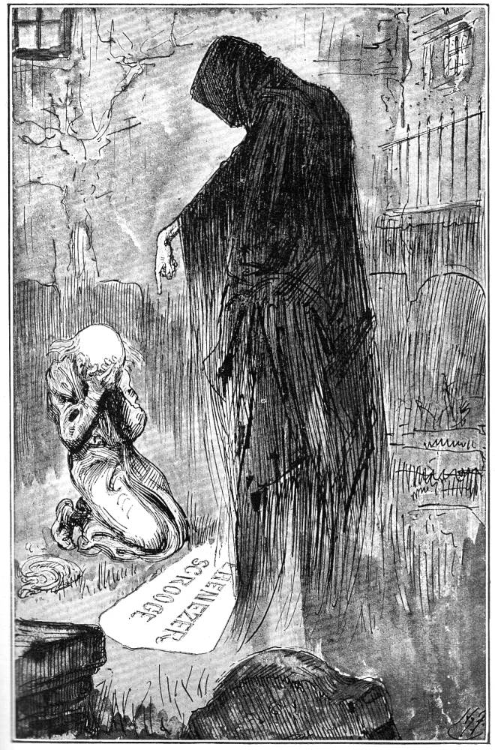
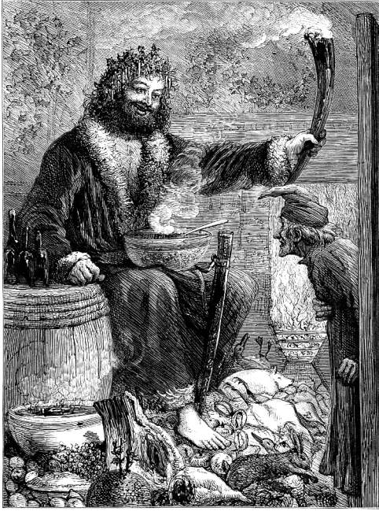
This presentation is Copyright All Rights Reserved 2001-2015, Charles R. Severance and others. Please do not record, remix, or reuse without explicit written permission.
#LAK15

